Slide 1
Possible Hibachi Restaurant near City hall, city of Chicago
Coursera Capstone
IBM Applied Data Science
The Battle of the Neighborhoods – Week 5

Slide 2
Business Problem:
The objective of this capstone project is to find the most suitable location for the entrepreneur to open a new Hibachi & Grill Restaurant in Downtown Chicago Area. We will be using data science methods and tools along with clustering.
This project aims to provide best solution to provide this entrepreneur, in Metro Chicago area where he can open a Hibachi style Restaurant . The best location in this case is related to other venues in the vincinity that attract visitors and tourists like restaurants, parks & museum near downtown Chicago. There are no Hibachi style restaurant near City hall in Chicago. This project will provide a best possible location to open a Hibachi restaurant in downtown Chicago near. City hall.

Slide 3
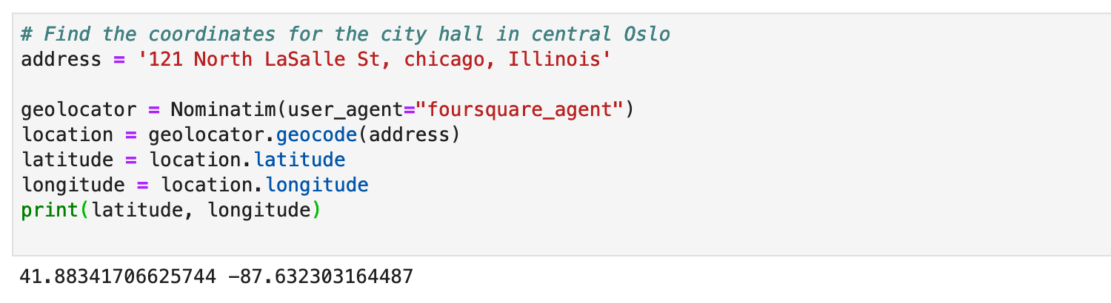
Data Collection:
I will be using the source data from Foursquare. I will be getting the coordinates for the City hall, city of Chicago using Foursquare.
Getting the Latitude and longitude for the city hall in downtown Chicago

Slide 4
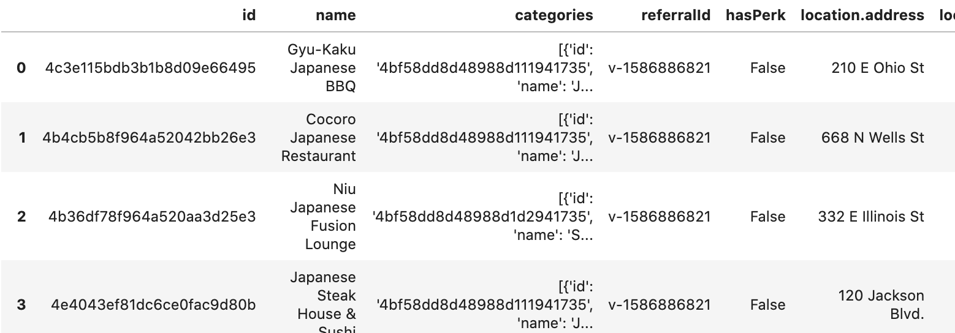
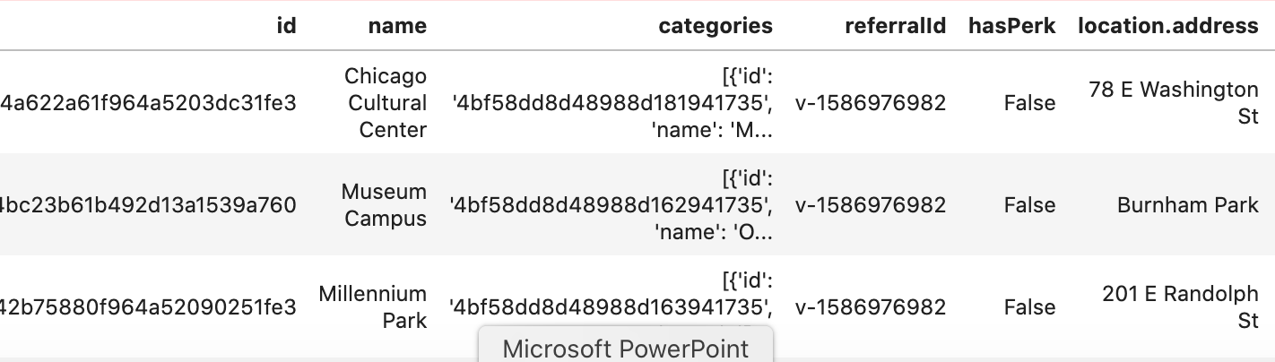
Getting the data of current Japanese non-hibachi restaurant
Getting the data for for parks and museum near downtown Chicago

Slide 5
Methodology
Getting latitude and longitude using Geocoder
Use Foursquare API to get venue data
Group data by venue and taking mean of the frequency of occurrence for each category
Filter venue category by restaurant
Perform Clustering on the data by using K-means clustering
Visualize the data using Folium
Graphical representation

Slide 6


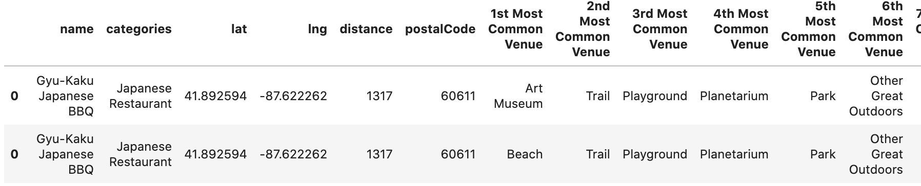
Results :
Categorized the results by observing the number of restaurants , parks and museum . Museum and parks always bring more people local or tourist, along with that we look at the type of Japanese restaurants it has in the vicinity

Slide 7
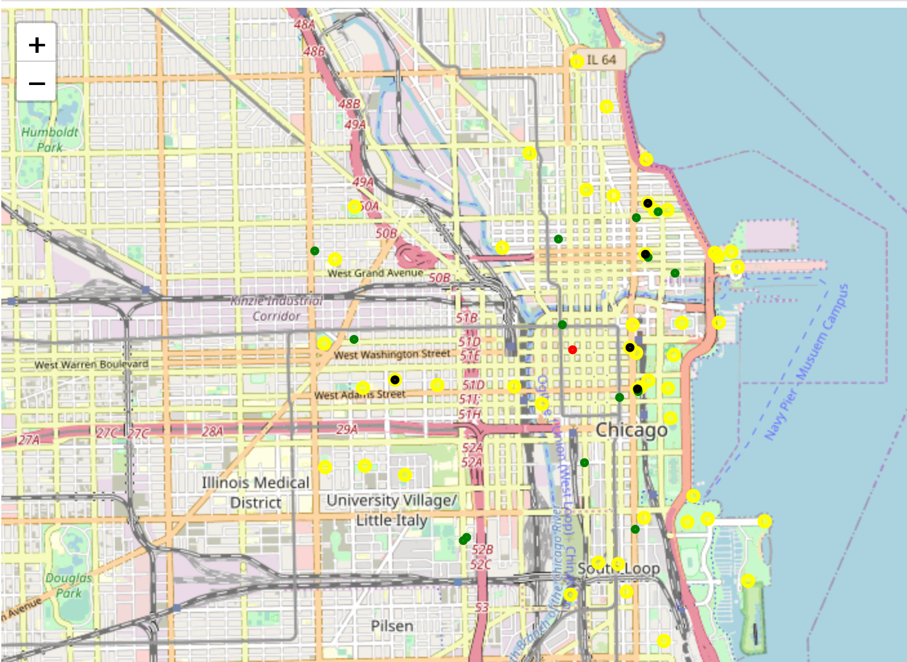
Combined map shows venue in city hall vacinity

Slide 8

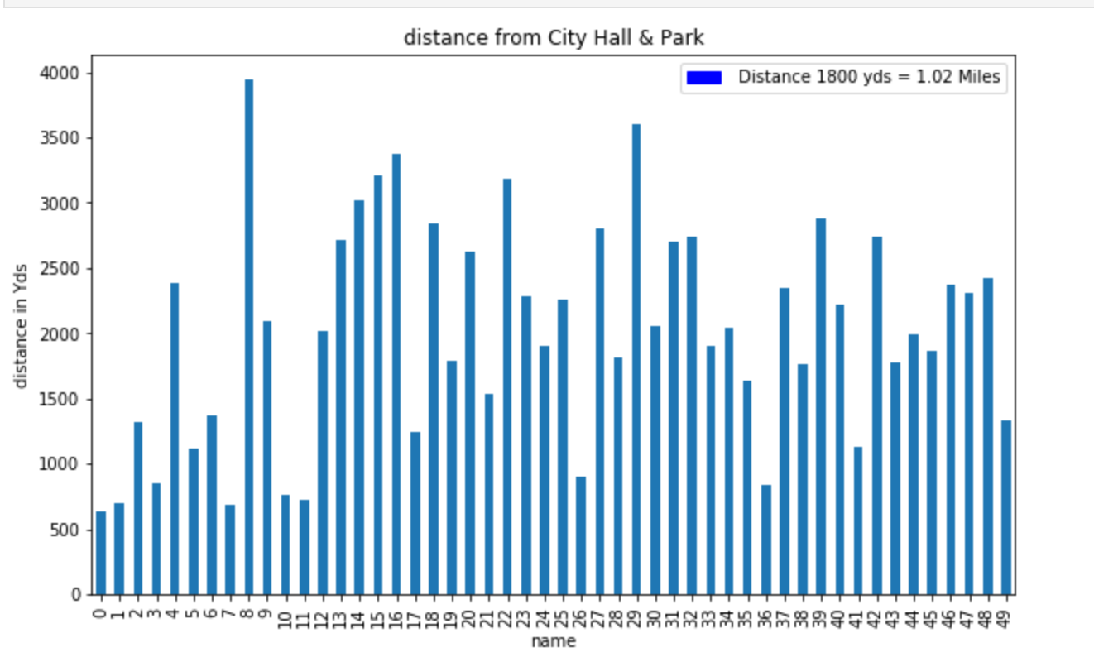
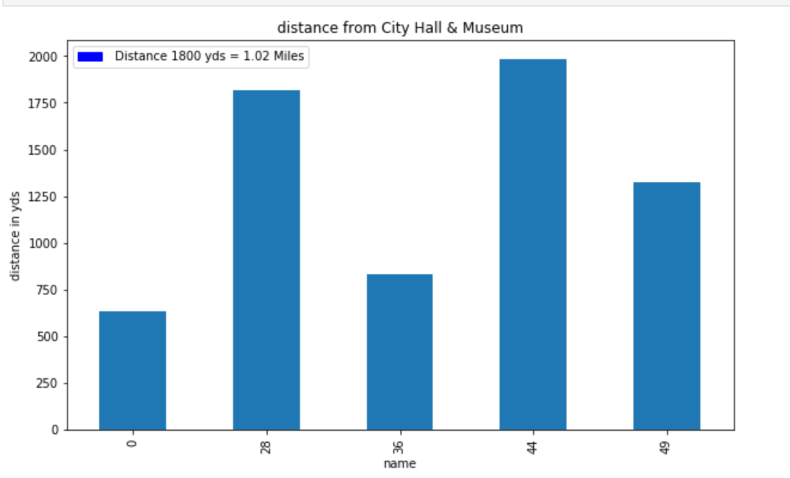
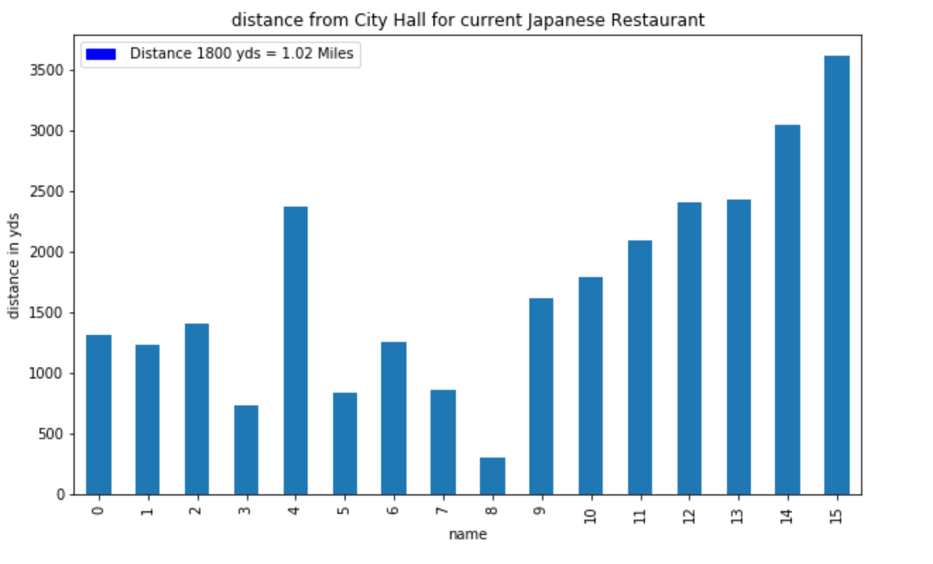
Graphical representations of distances of various venues in respect to city hall, Chicago
z

Slide 9
Observation:
Looking at the Graphical overview of the combined locations of existing Japanese non-hibachi restaurants, and the location of nearby parks and also museums. We see that surrounding the City Hall Chicago, based on visual analysis , that there are plenty of opportunities of Hibachi restaurants circled by a park or Museum. These venues combinations produces tourists,visitors locals as well as visitors all year around. More visitors means better chance for a restaurant specially specialty restaurants.

Slide 10
Proposal
As a proposal for the project :
>> Best place to open up a Hibachi style restaurant is within 1 miles from the city hall, Chicago , moreover currently no Hibachi style restaurant are in downtown , that is very favorable for opening one.
>> The number of locals and tourist in downtown chicago very high due to tourist places and parks which makes the location favorable and business will be good.

